Slide 1
AI for Kids
UK Robotics Week 2024

Slide 2
This Story is about my story is about a scientist living in the 2040s or 2015 and onwards he is or she is a child today but trying to learn how to prepare for the future with generative AI to become a better scientist in the future
This story is created by:
John
Mary
Manal

Slide 3
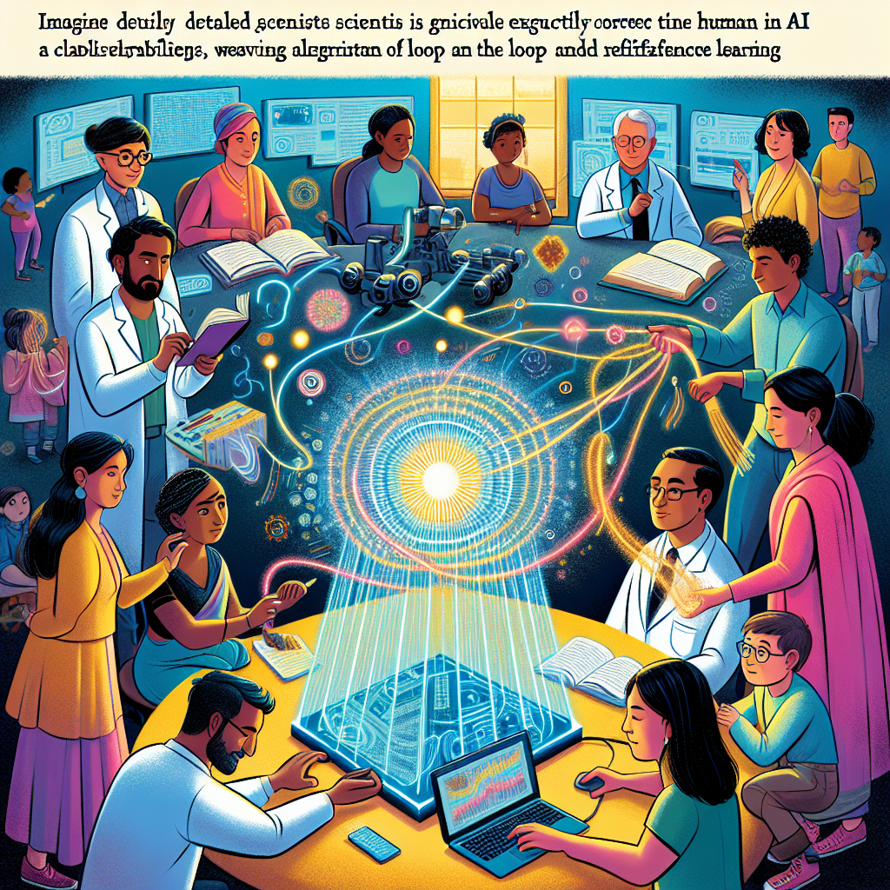
In the story, the child learns about using reinforcement learning to correct AI mistakes. The child imagines scientists working with AI, troubleshooting errors and enhancing its capabilities. The child envisions themselves as
part of the process, contributing to the improvement of AI through human-in-the-loop interaction. The story focuses on the importance of understanding and participating in the development of AI technology for a better future.
Imagine a detailed illustration representing scientists engaging in daily activities, where they are utilizing narrative AI effectively in their work. This ensemble is mixed with different gendered and raced individuals. One scientist, a South Asian man, diligently corrects an AI error, adjusting algorithms on a large, floating holographic screen. A Hispanic woman next to him is seen enhancing AI capabilities, weaving intricate lines of code that materialize into a radiating sphere of light. Together, they exemplify the Human in the Loop and reinforcement learning methods. This is intended for a page in a children's storybook, so the style should be vibrant and engaging, making these complex tasks understandable and invigorating.

Slide 4
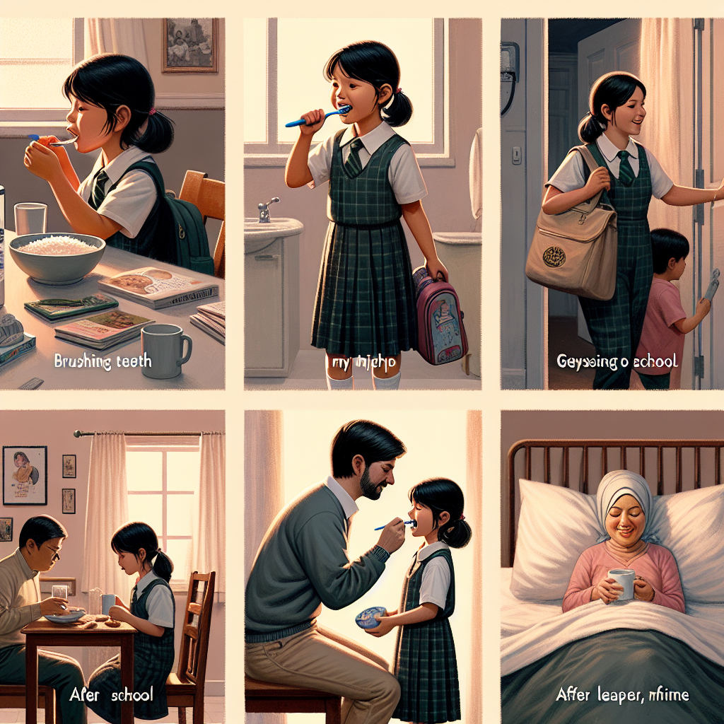
In the story, the child focuses on studying to become a scientist in reinforcement learning. The child visualizes using narrative AI to fix
AI errors. The child's daily routine involves going to school and learning about AI. Next, the child uses generative AI to enhance their knowledge.
Illustrate a day in the life of a child attending primary school. Start with the child, of South Asian descent and female gender, waking up early in the morning. Show her brushing her teeth, getting dressed in her school uniform, and having breakfast. Follow the child as she goes on a journey to school, interacting with AI-assisted learning technology. After school, she returns to a home filled with warmth from her Caucasian father and Hispanic mother. Capture these everyday moments in the style of a classical realist painting, with attention to textures, light, and detail.

Slide 5

In the story, the young student learns about the role of scientists in improving AI through reinforcement learning. The adventures include waking up,
going to school, and learning about AI. As the student advances to high school and studies chemistry, narrative AI helps them understand complex concepts.
Depict a scene of a high school student engaged in studying chemistry utilizing narrative artificial intelligence. The student, a Hispanic girl with shoulder-length dark hair, sits at a desk covered in notes and textbooks. She's communicating with an AI system on her laptop, which provides illustrated explanations of various chemical reactions. It also questions her to test her understanding, making the learning process interactive. The mood of the scene is thoughtful and focused, showcasing the fusion of education and technology in a contemporary setting.

Slide 6
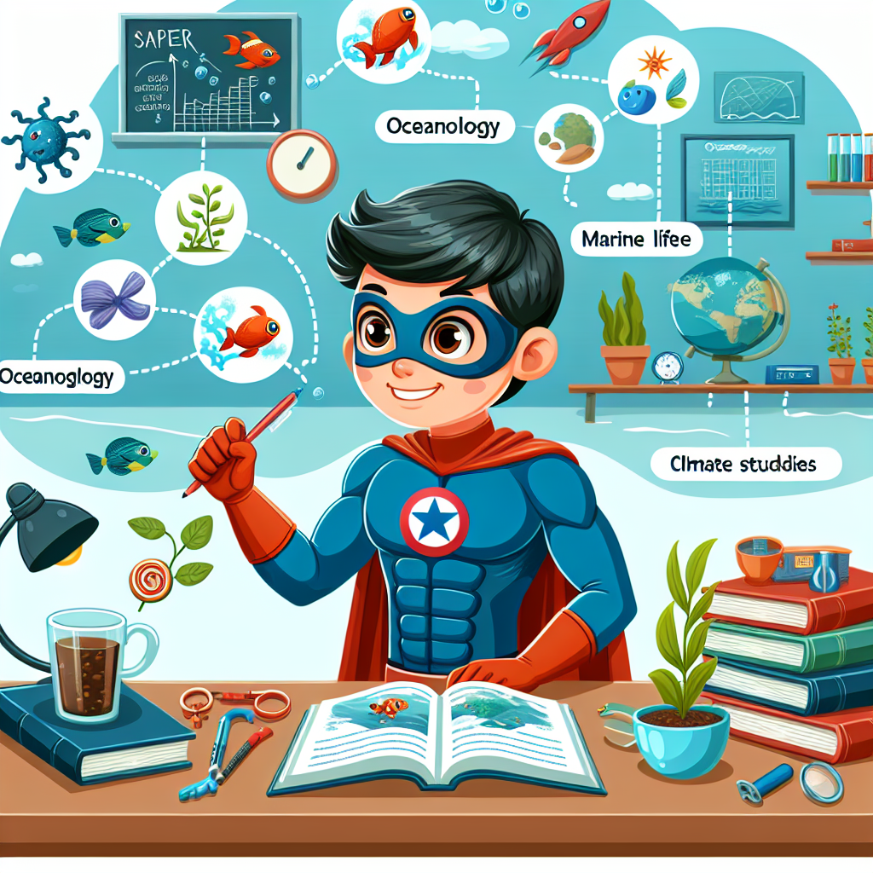
In primary school, kids can start learning about studying AI and its practical applications in daily life. As they progress through education, they can explore how AI can improve various fields like science and oceanography. By
understanding AI early on, they can be prepared for future careers that involve working with advanced technology. Let's make learning about AI fun and engaging for kids to spark their interest and curiosity in this exciting field.
Create a fun illustration for a children's storybook. In this image, display a superhero character at a university setting, engaged in studying ocean life, expressing eagerness to become a marine biologist. They should appear focused and curious, surrounded by books and tools related to oceanography, marine biology, and climate studies. Also, illustrate some visual elements indicating the factors impacting the oceanic ecosystem. Make this superhero visual creative, taking care not to resemble any known superheroes, and ensure gender and descent balance for this character.

Slide 7
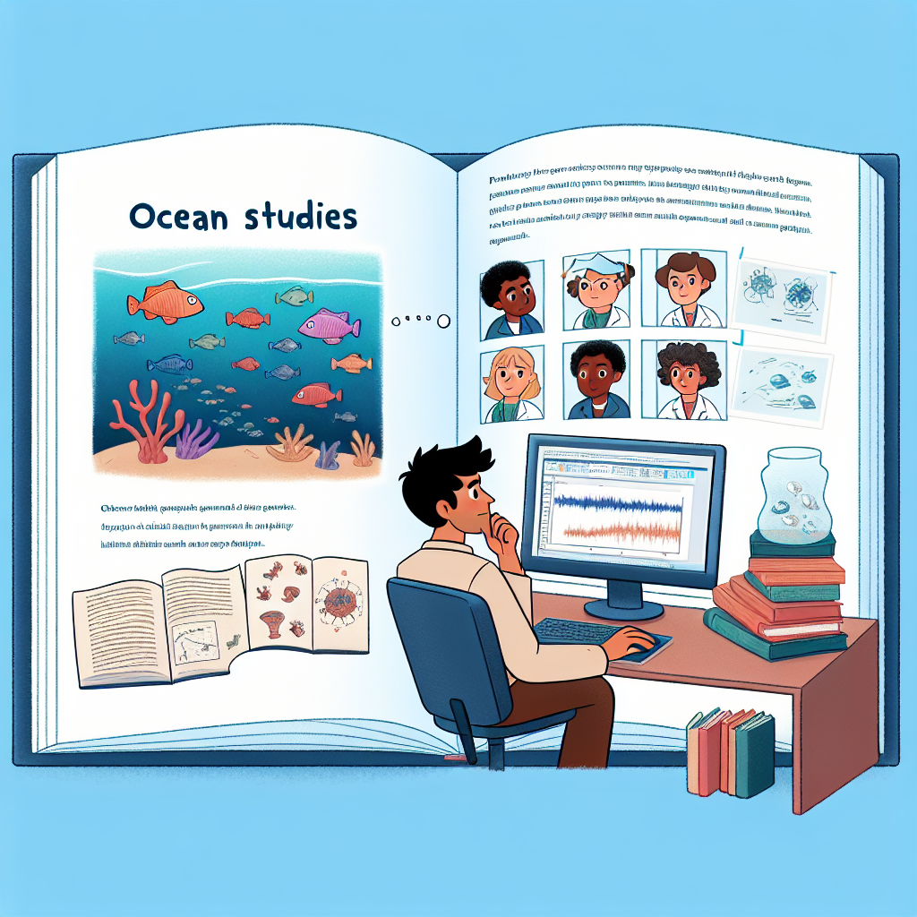
In the storytelling journey, the character evolves from a primary school student fascinated by AI to a high school student applying
AI in chemistry studies, then a university student pursuing a career in ocean science using generative AI to propose groundbreaking research ideas.
Create an image of a page from a children's story book. The page depicts a recently graduated scientist, agnostic of gender, with varied racial backgrounds, sitting in front of their computer. They're researching ocean studies for their upcoming PhD proposal. Some books and diagrams about marine life are scattered around. The scientist has a thoughtful expression, as they deliberate on finding a unique niche in the literature to focus their work.

